Slide 1

Lecture 1: Introduction to Data Science
Dr. Jia Uddin
AI and Big Data Department
Endicott College, Woosong University
Daejeon, South Korea
Email: jia.Uddin@wsu.ac.kr
https://sites.google.com/view/drjiauddin/home?authuser=2

Slide 2
Course Text:
Laura Igual, Santi Segui, “Introduction to Data Science – A Python approach to concepts, techniques and applications”, Springer.
Glenn J. Myatt, Wayne P. Johnson, “Making Sense of Data I - A Practical Guide to Exploratory Data Analysis and Data Mining”, 2nd edition, Wiley.
Introduction to Data Analytics: A Complete Guide to Beginners, Jia Uddin, First Edition, Woosong Publisher, Daejeon, South Korea, 2021, page-1-178, ISBN: 979-11-6110-110-1

Slide 3
Course Text:
Description
In course is designed for undergraduate students of Technology Studies department. The purpose of this course is to describe both theoretical and practical approach for making sense out of data. A step-by-step process is introduced, which is designed to walk you through the steps and issues that you will face in data analysis or data detection projects. It covers the more common tasks relating to the analysis of data including (1) how to prepare data prior to analysis, (2) how to generate summaries of the data, (3) how to identify non-trivial facts, patterns, and relationships in the data, and (4) how to create models from the data to better understand the data and make predictions. The ultimate goal of this course is to learn the skills need be a data scientist. Several hands-on lab sessions will also be the part of this course related to the lecture topics using MATLAB and Python programming tool.

Slide 4
Course Text:
The course objectives are:
To understand the basic on different types of data and its characteristics
To apply techniques about optimization and tuning to improve run-time of classification algorithms
To build predictive models using a variety of AI based learning techniques
To analyze and compare the performances of learned models using suitable metrics
To understand and apply deep learning techniques for solving problems

Slide 5
Course Text:
Course Requirements & Grading
Component |  | Weight
Attendance |  | 20%
Continuous Evaluation/Assignments |  | 20%
Mid-term |  | 20%
Final Examination |  | 40%

Slide 6
Course Text:
Grading Scale
Grade | Grade Point Average Range | Definition | Percent Equivalent
A+ | 4.25 ~ 4.50 | Exceptional Achievement | 95 - 100
A | 3.75 ~ 4.24 | Outstanding Achievement | 90 – 94
B+ | 3.25 ~ 3.74 | Very Good Achievement | 85 - 89
B | 2.75 ~ 3.24 | Good Achievement | 80 - 84
C+ | 2.25 ~ 2.74 | Satisfactory Achievement | 75 - 79
C | 1.75 ~ 2.24 | Average Achievement | 70 - 74
D+ | 1.25 ~ 1.74 | Minimal Achievement | 65 - 69
D | 0.75 ~ 1.24 | Minimal Achievement | 40 - 64
F | 0 ~ 0.74 | Unsatisfactory Achievement | 0 - 39

Slide 7
Grading Curve
Grade | Grade Point | Freshman | Sophomores | Junior | Graduate
A+ | 4.5 | 20% or less | 30% or less | 30% or less | 50% or less
A | 4.0
B+ | 3.5 | 50% or less | 40% or less | 40% or less | 50% or less
B | 3.0
C+ | 2.5 | 30% or more | 30% or more | 30% or more | ~
C | 2.0
D+ | 1.5
D | 1.0
F | 0 | Not included in calculations
Example: 20 students
A+ ~ A0: 6 students
B+ ~ B0: 8 students
C+ ~ D0: 6 students

Slide 8
Course Text:
Upon successful completion of this course, students will be able to:
After successful completion of this course, students will be able to:
describe the characteristics of different types of data
apply data preprocessing techniques (qualitive skills)
apply techniques about optimization and tuning to improve run-time of classification/predictive algorithms (Critical Thinking Skills)

Slide 9
Data
Data encompasses a collection of discrete objects, numbers, words, events, facts, measurements, observations, or even descriptions of things
are the raw facts
Raw indicates the facts have not been processed to reveal meaning
Information
result of processing raw data to reveal its meaning
consists of transformed data and facilitates decision making

Slide 10


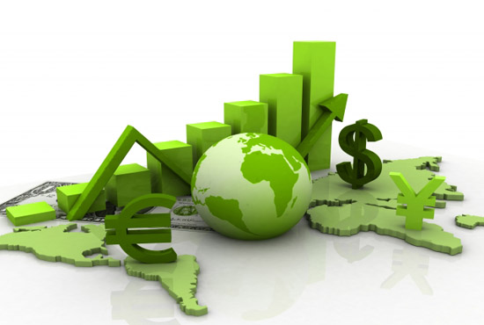

Data All Around
Lots of data is being collected and warehoused
Web data, e-commerce
Financial transactions, bank/credit transactions
Online trading and purchasing
Social Network
IoT Sensors

Slide 11
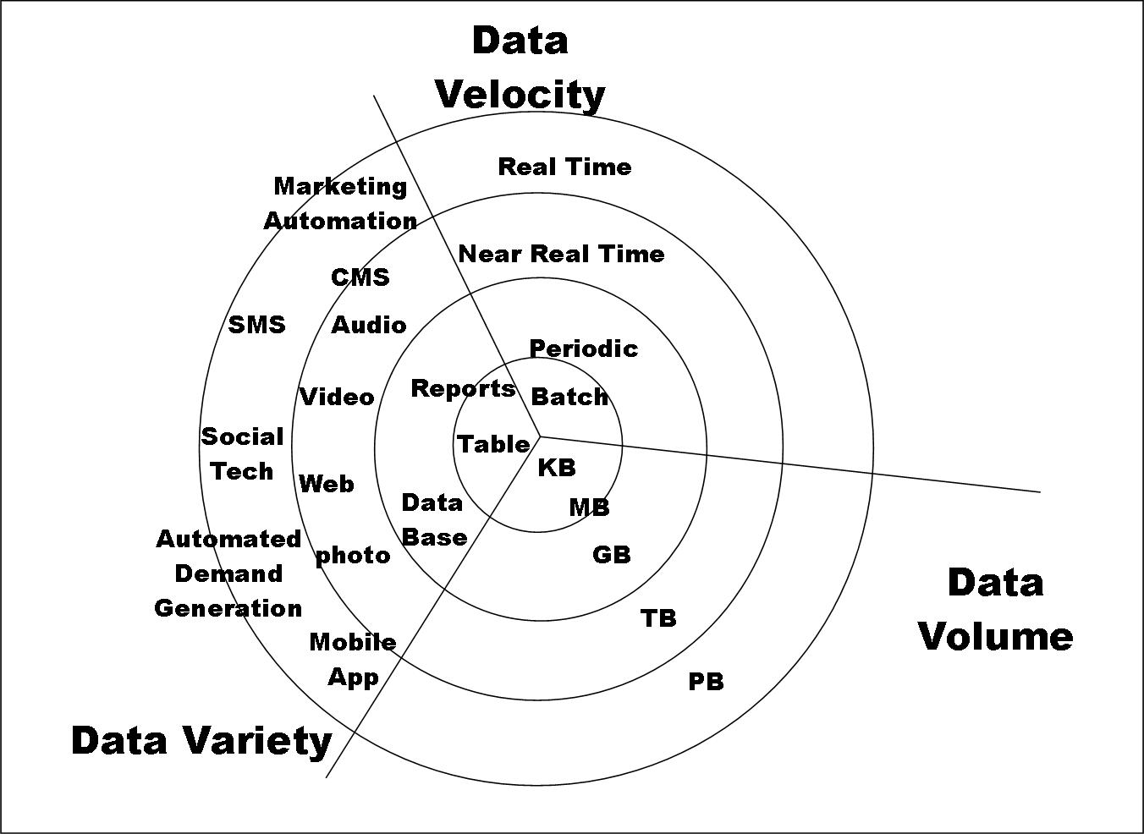
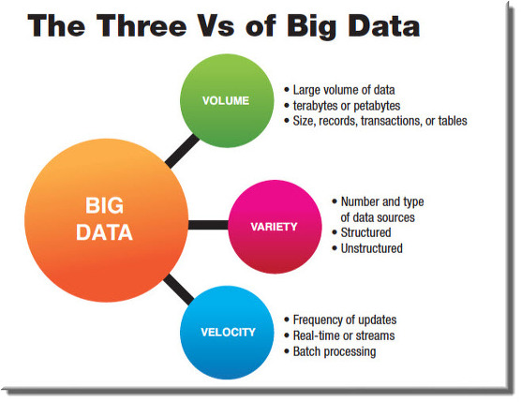
Big Data
Big Data is any data that is expensive to manage and hard to extract value from
Volume
The size of the data
Velocity
The latency of data processing relative to the growing demand for interactivity
Variety and Complexity
the diversity of sources, formats, quality, structures.

Slide 12
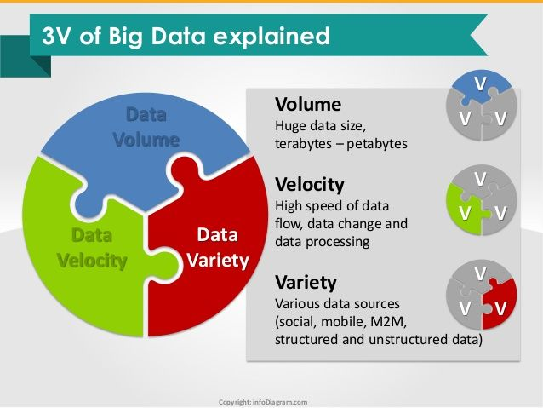
3V
Notes:
https://zeonisko.tistory.com/259

Slide 13
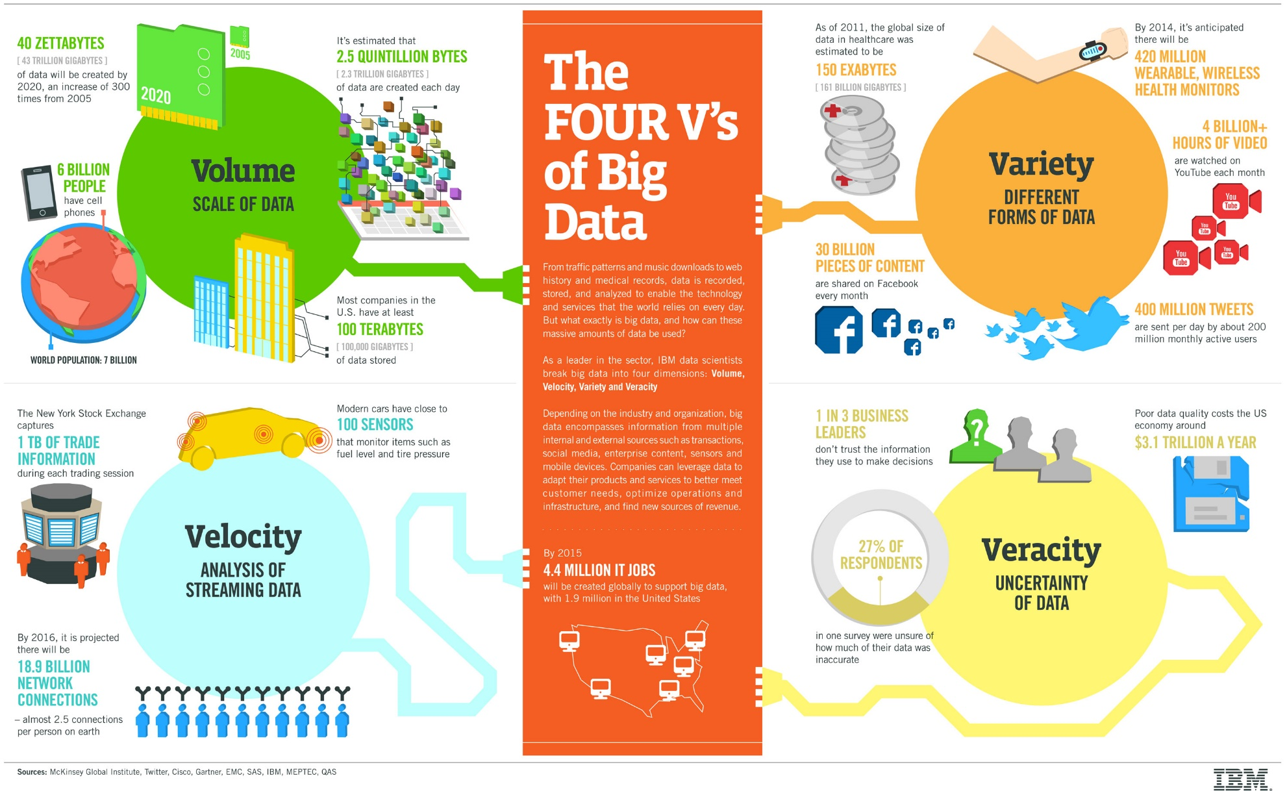
Volume-Size
Velocity-Speed
Variety- variety
Veracity-Accuracy
Notes:
https://m.blog.naver.com/PostView.nhn?blogId=autocadplus&logNo=10141890943&proxyReferer=https:%2F%2Fwww.google.com%2F

Slide 14
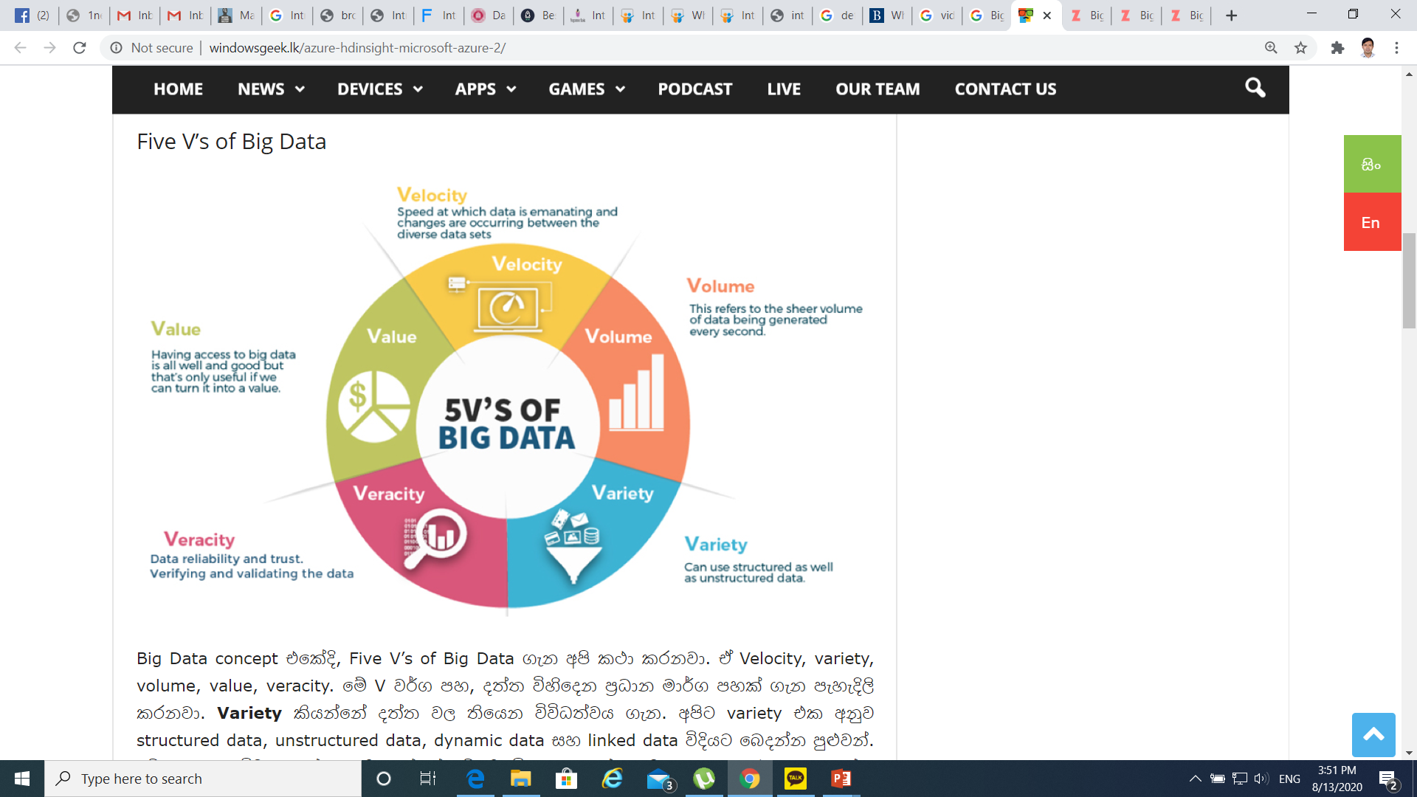
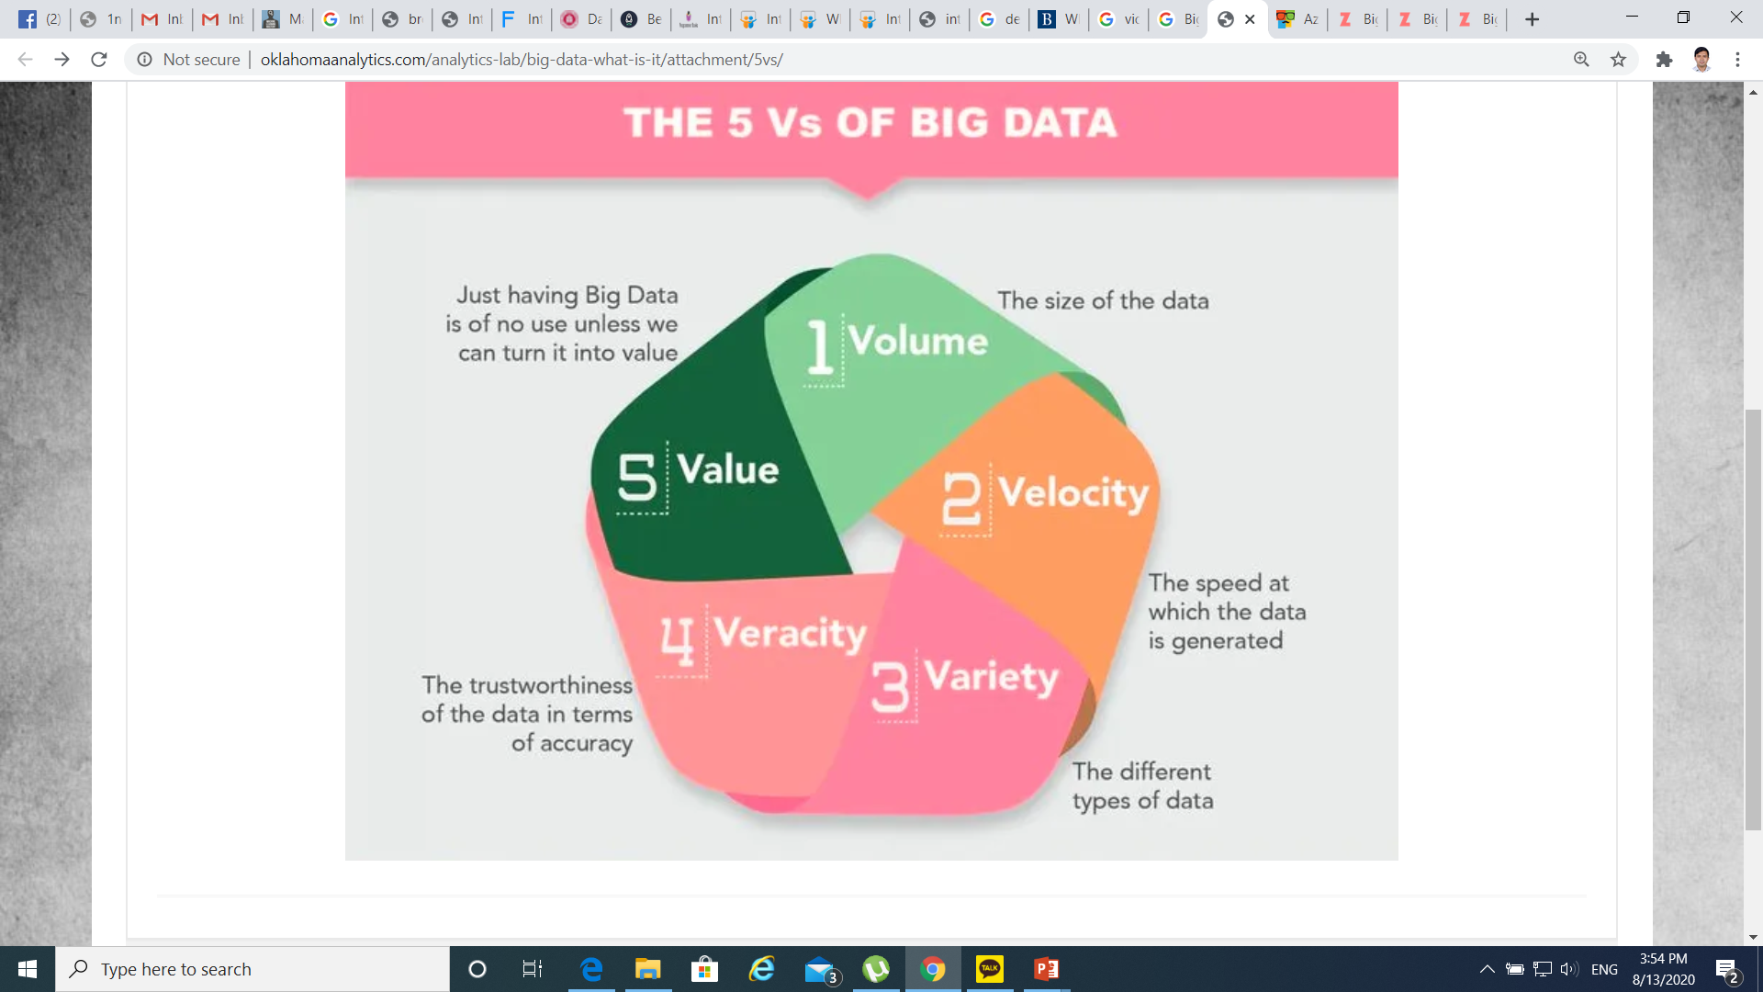

Slide 15
What is Data Science?
An area that manages, manipulates, extracts, and interprets knowledge from tremendous amount of data
Data science (DS) is a multidisciplinary field of study with goal to address the challenges in big data
Data science principles apply to all data – big and small
https://hbr.org/2012/10/data-scientist-the-sexiest-job-of-the-21st-century/

Slide 16
What is Data Science?
Theories and techniques from many fields and disciplines are used to investigate and analyze a large amount of data to help decision makers in many industries such as science, engineering, economics, politics, finance, and education
Computer Science
Pattern recognition, visualization, data warehousing, High performance computing, Databases, AI
Mathematics
Mathematical Modeling
Statistics
Statistical and Stochastic modeling, Probability.

Slide 17
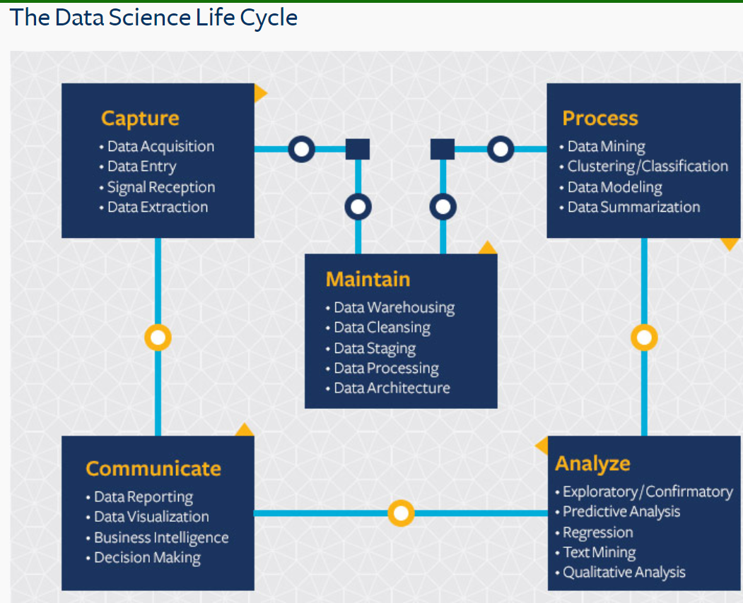
What is Data Science?
Notes:
https://ischoolonline.berkeley.edu/data-science/what-is-data-science/

Slide 18
What Is Data Science?
https://www.youtube.com/watch?v=X3paOmcrTjQ

Slide 19
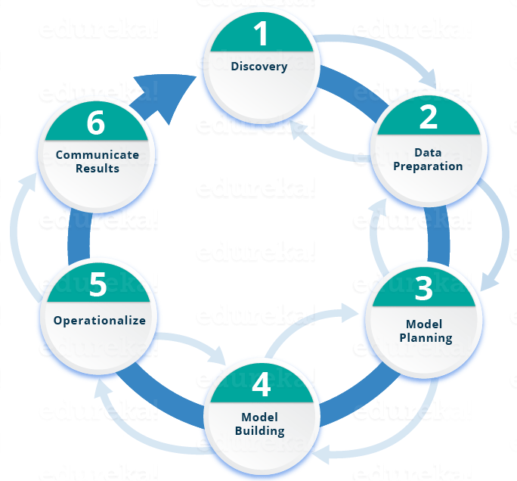
Data Science Lifecycle

Slide 20
Case Study: Diabetes Prevention
https://www.edureka.co/blog/what-is-data-science/
What if we could predict the occurrence of diabetes and take appropriate measures beforehand to prevent it?

Slide 21
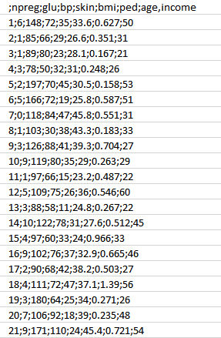
Step 1:
Attributes:
npreg – Number of times pregnant
glucose – Plasma glucose concentration
bp – Blood pressure
skin – Triceps skinfold thickness
bmi – Body mass index
ped – Diabetes pedigree function
age – Age
income – Income

Slide 22
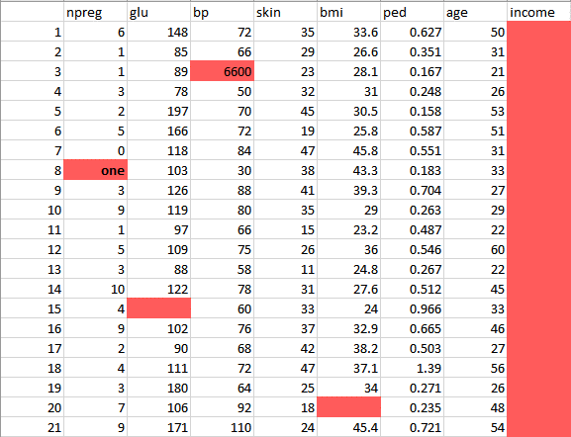
Step 2:
need to clean and prepare the data for data analysis
has a lot of inconsistencies like missing values, blank columns, abrupt values and incorrect data format
have to organize the data into a single table under different attributes

Slide 23
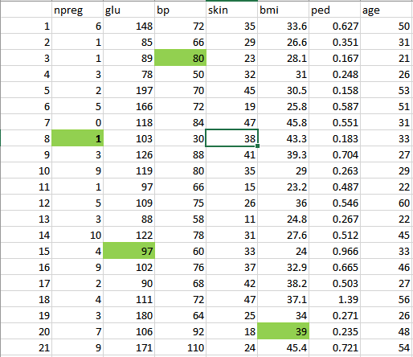
After Step 2: Preprocessing
Before Preprocessing
After Preprocessing

Slide 24
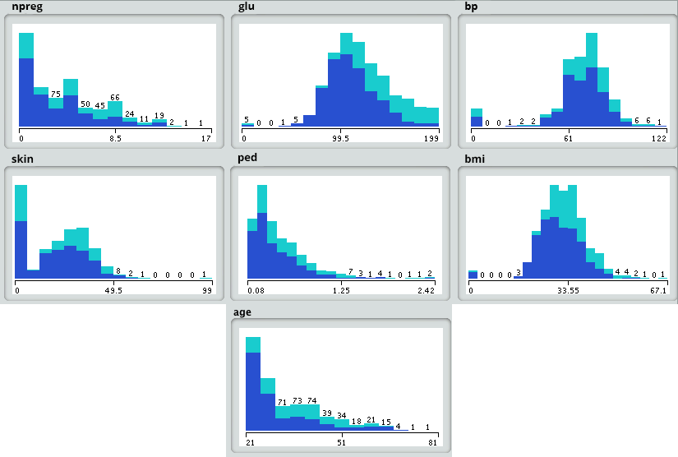
Step 3: Model Planning
load the data into the analytical sandbox and apply various statistical functions on it
For example, R has functions like describe which gives us the number of missing values and unique values. We can also use the summary function which will give us statistical information like mean, median, range, min and max values.
Then, we use visualization techniques like histograms, line graphs, box plots to get a fair idea of the distribution of data.

Slide 25
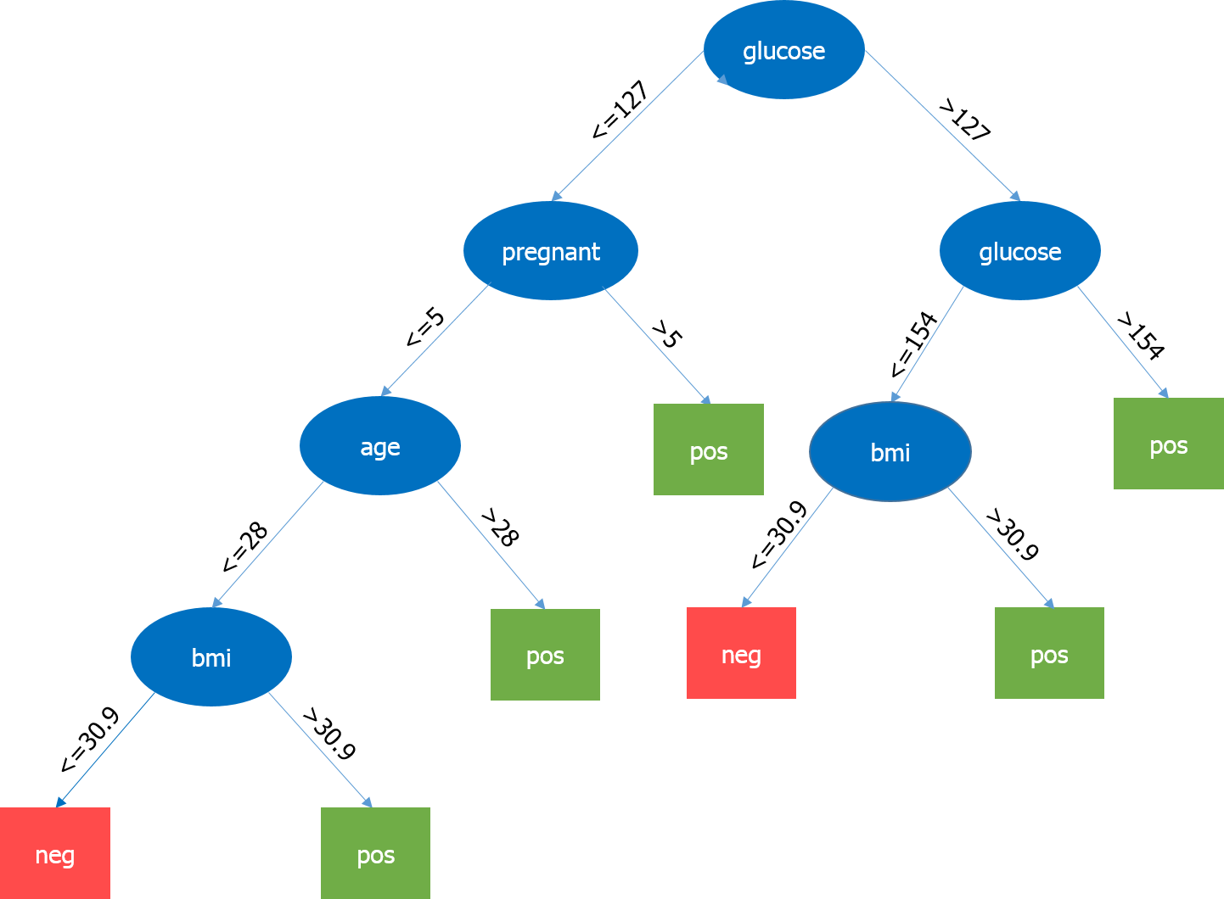
Step 4: Model Building
the most important parameter is the level of glucose, so it is our root node
Now, the current node and its value determine the next important parameter to be taken
It goes on until we get the result in terms of pos or neg

Slide 26
Step 5: Operationalize
run a small pilot project to check if our results are appropriate.
will also look for performance constraints if any
If the results are not accurate, then we need to re-plan and rebuild the model

Slide 27
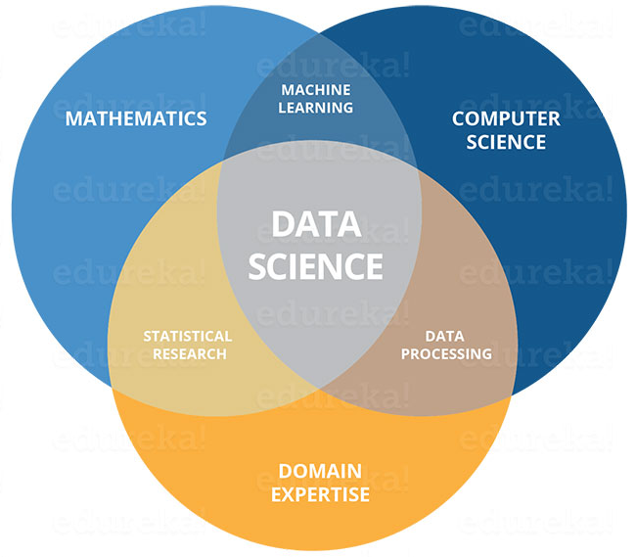
Step 6: Communications Results
Once we have executed the project successfully, we will share the output for full deployment.

Slide 28
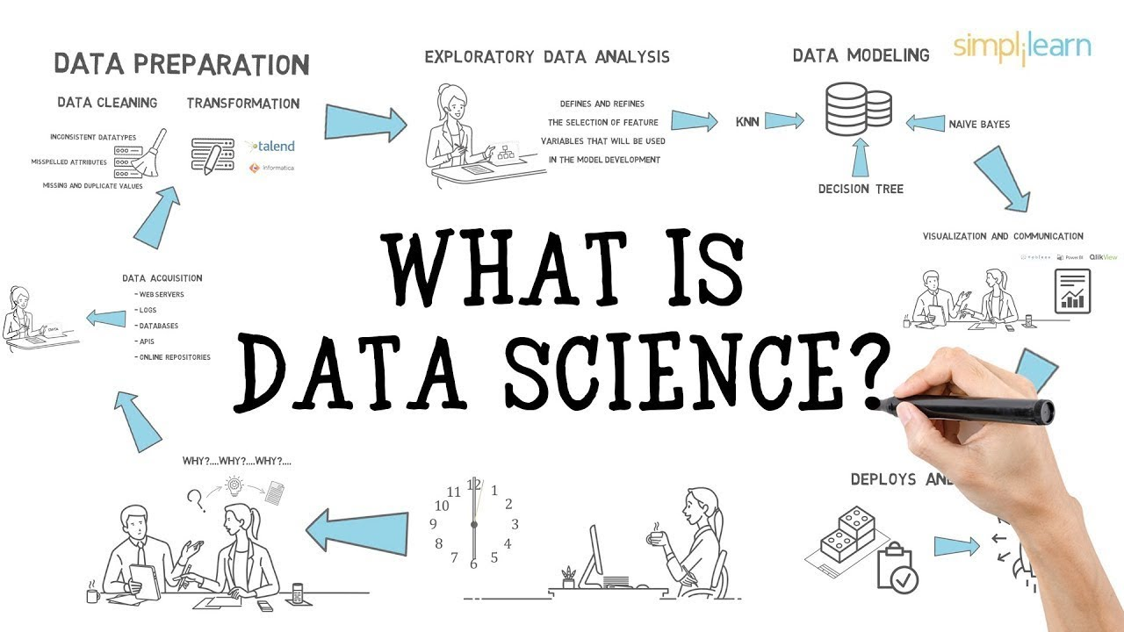
What is Data Science

Slide 29
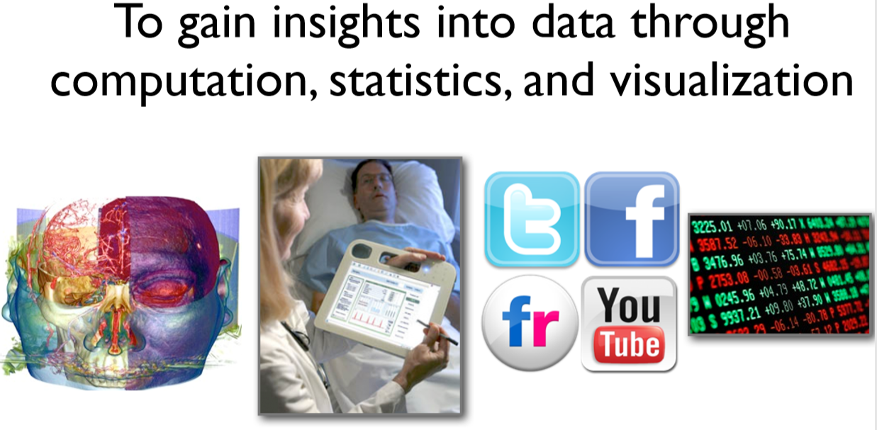
Data Science

Slide 30
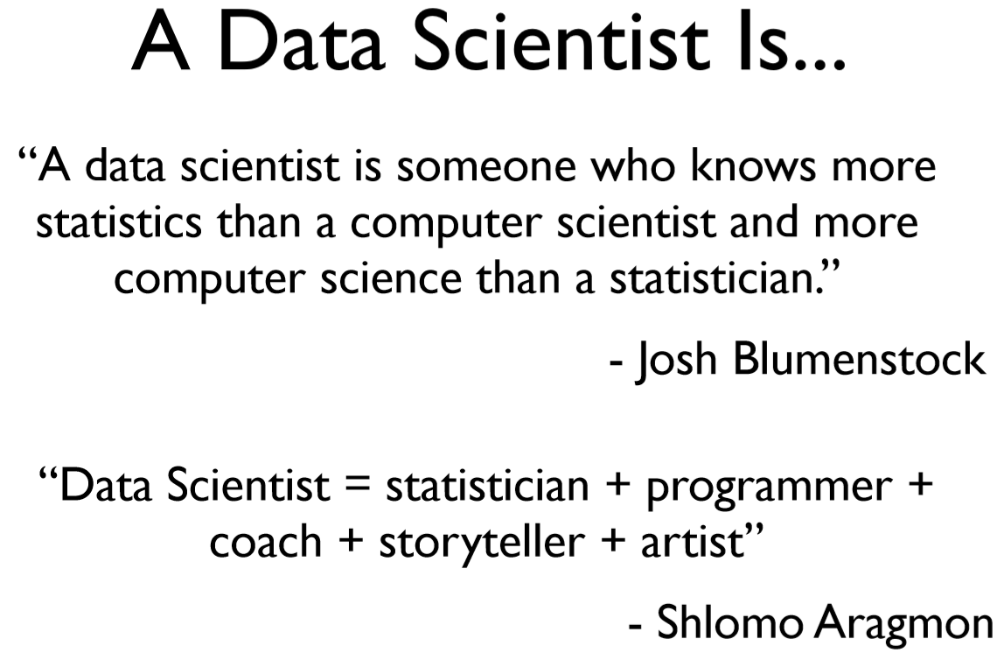

Slide 31
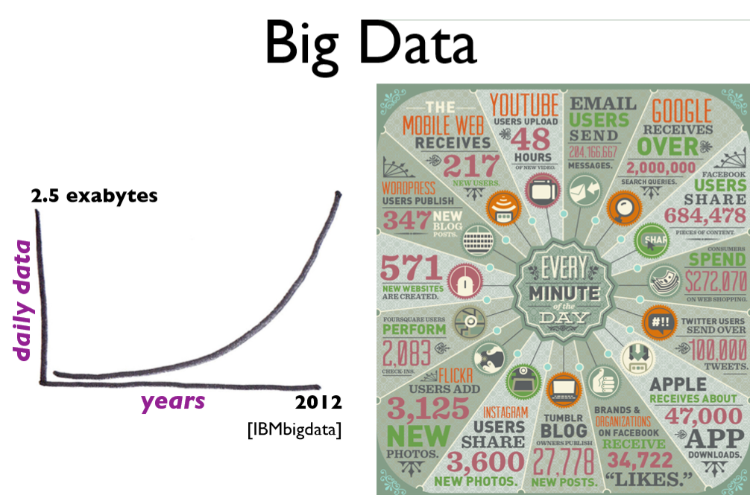

Slide 32
Real Life Examples
Companies learn your secrets, shopping patterns, and preferences
For example, can we know if a woman is pregnant, even if she doesn’t want us to know? Target case study
Data Science and election (2008, 2012)
1 million people installed the Obama Facebook app that gave access to info on “friends”
How Companies Learn Your Secrets (Target marketing)
https://www.nytimes.com/video/magazine/100000001367956/timescast--retailers-predictions.html?action=click&gtype=vhs&version=vhs-heading&module=vhs&region=title-area&cview=true&t=4

Slide 33
Definition of a time series data
A time series is a sequential set of data points, typically measured over successive times.
Mathematically, defined as a set of vectors x(t), t=0,1,2,3…..) where t represents the time elapsed
Notes:
https://www.itl.nist.gov/div898/handbook/pmc/section4/pmc4.htm
https://www.slideshare.net/yush313/time-series-3000944

Slide 34
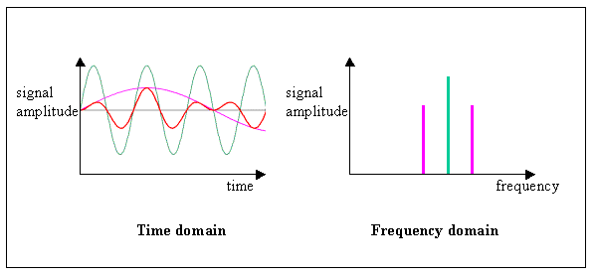
Time domain vs Frequency domain
Time domain refers to the analysis of mathematical functions or signals or data with respect to time, rather than frequency
Frequency domain refers to the analysis of mathematical functions or signals or data with respect to frequency, rather than time
Notes:
https://www.itl.nist.gov/div898/handbook/pmc/section4/pmc4.htm
https://www.slideshare.net/yush313/time-series-3000944

Slide 35
Examples of time series data
Profit earned by a company for each of the past five years
Workers employed by a company for each of the past 15 years
No of students registered for a examination in the institute for the past 5 years
Weekly wholesale price index for each of the past 30 week
No of road accidents in a city for each day for the past two years
Many more………..
Notes:
https://www.itl.nist.gov/div898/handbook/pmc/section4/pmc4.htm
https://www.slideshare.net/yush313/time-series-3000944

Slide 36
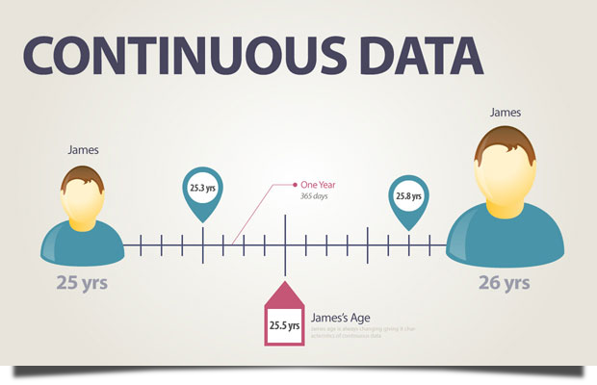
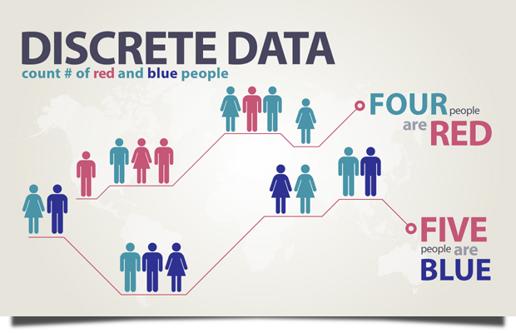
Continuous vs Discrete time series
Continuous: observations are measured at every instance of time.
Data comes from measuring and can take any value within a given range
For example, weight of a banana, height of specific groups of people
Discrete: data can only take certain values
For example, shoe sizes, no of children in a class, no of sweets in a packet
Notes:
https://www.itl.nist.gov/div898/handbook/pmc/section4/pmc4.htm
https://www.slideshare.net/yush313/time-series-3000944

Slide 37
More on Definition
An ordered sequence of values of a variable at equally spaced time intervals
Or
A time series is a set of observation taken at specified times, usually at equal intervals
Time series establish relation between ‘cause’ and ‘effects’
One variable is ‘Time’ which is independent variable and second is ‘Data’ which is dependent variable
Applications:
The usage of time series models:
Obtain an understanding of the underlying forces and structure that produced the observed data
Fit a model and proceed to forecasting, monitoring or even feedback and feedforward control.
Time series methods take into account possible internal structure in the data
Notes:
https://www.itl.nist.gov/div898/handbook/pmc/section4/pmc4.htm
https://www.slideshare.net/yush313/time-series-3000944

Slide 38
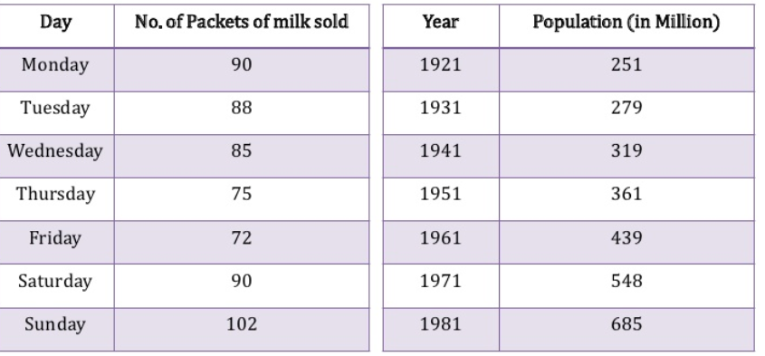
Examples of time series data
1st example: sale of milk packets is decreasing from Monday to Friday and then start to rise
2nd example population of a particular country is continuously increasing
Notes:
https://www.slideshare.net/yush313/time-series-3000944

Slide 39
Forecasting
Analyze time series data to detect the pattern that will help us to forecast future values of the time series
For example, University often try to forecast the number of students who will be applying for their institution
Many company attempt to predicts the demand for their products and their share of the market

Slide 40
Applications of Time Series Analysis
Time Series Analysis is used for many applications such as:
Economic Forecasting
Sales Forecasting
Budgetary Analysis
Stock Market Analysis
Yield Projections
Process and Quality Control
Inventory/stock Studies
Workload Projections
Utility Studies
Census Analysis
and many, many more...
Notes:
A census is the procedure of systematically acquiring and recording information about the members of a given population…

Slide 41
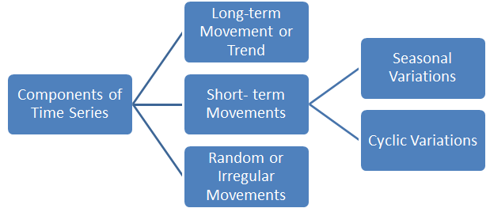
Component of Time Series
The changes in the time series effected by Economic, Social, Natural, Industrial, Political Reasons
These reasons are components of time series
Components of a Time series:
Trend (T)
Seasonal variation (S)
Cyclical variation (C)
Irregular variation (I)

Slide 42
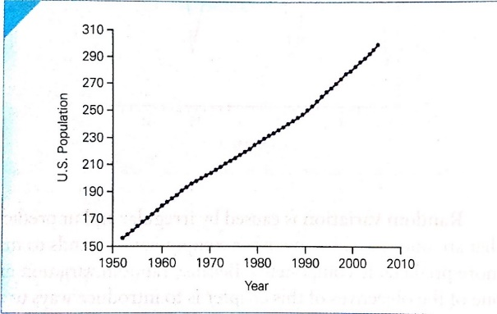
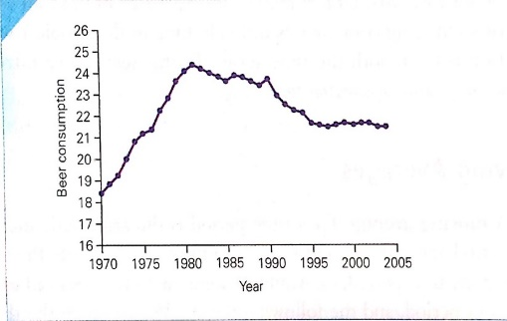
Secular trend
It is relatively consistent movement of a variable over a long period
Basic tendency of a series to grow or decline over a period of time
The increase or decrease in the movements of time series
Upward or downward trend may be due to
-> increase in population (ex. population increases over a period of time, price increases over a period of years)
-> change in technological progress
-> large scale shift in consumers demands (ex. sale of a commodity may decrease over a period of time as better products coming in the market)
Not always linear
Notes:
https://www.kluniversity.in/arp/uploads/2093.pdf

Slide 43
Secular trend is influenced by
Population
Productivity improvement
Technological changes
Market changes

Slide 44
Commonly used methods for depicting secular trends
Freehand drawing
Semi-average
Least-square method
Exponential smoothing
Notes:
https://www.slideshare.net/DrFereidounDejahang/1634-time-series-and-trend-analysis

Slide 45
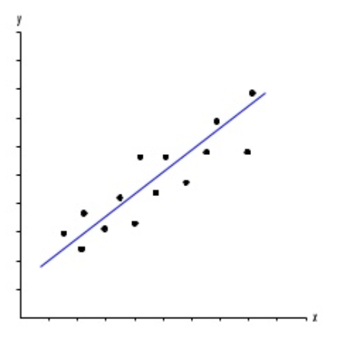
Freehand drawing
Plotting the data on a scatter diagram
A scatterplot displays the relationship between 2 numeric variables. For each data point, the value of its first variable is represented on the X axis, the second on the Y axis.
Notes:
https://www.slideshare.net/DrFereidounDejahang/1634-time-series-and-trend-analysis
https://www.data-to-viz.com/graph/scatter.html

Slide 46
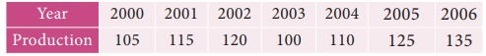
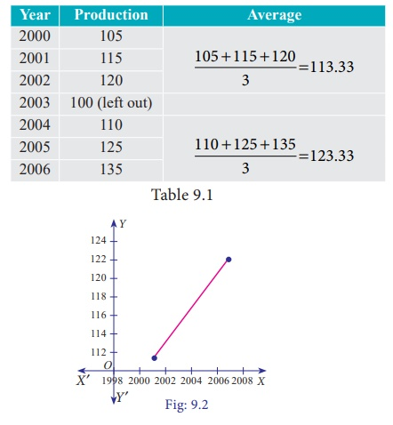
Semi average
In this method, the semi-averages are calculated to find out the trend values.
Procedure:
The data is divided into two equal parts.
In case of odd number of data, two equal parts can be made simply by omitting the middle year.
The average of each part is calculated, thus we get two points.
Join the two points by a straight line.
The straight line can be extended on either side.
This line is the trend line by the methods of semi-averages.
(i) The future values can be predicted.
(ii) The trend values obtained by this method and the predicted values are not precise.
Notes:
https://www.slideshare.net/DrFereidounDejahang/1634-time-series-and-trend-analysis
https://www.data-to-viz.com/graph/scatter.html
https://www.brainkart.com/article/Measurements-of-Trends--Method-of-Semi-Averages_39016/

Slide 47
Seasonal variation
are short-term fluctuation in a time series that occur periodically in a year
It continues to repeat year after year
->ex. More woolen clothes sold in winter than in the summer
-> ice creams are sold more in summer and very little in winter season each year
-> sales in a departmental stores are more during festive seasons that in the normal days
-> students enrollment in different semesters
->Electricity consumption per month in a year

Slide 48
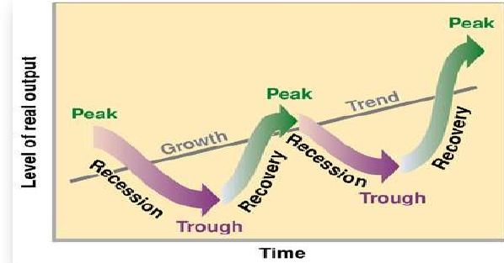
Cyclical variation
Cyclical variations are recurrent upward or downward movements in a time series but period of cycle is greater than a year( usually 3~12 years based on nature of time series)
These variations are not regular as seasonal variation
->ex. A business cycle- prosperity, recession, depression, and recovery
Most commonly seen in business(world fashion, profits of business house, demand for a particular brand of product, etc.)
Notes:
Recurrent-occurring often or repeatedly.
https://thephysicspi.blogspot.com/2019/02/cyclical-variation.html

Slide 49
Irregular variation
are fluctuations in time series for short in duration
not regular in pattern or movement, unpredictable.
These variations are not regular as seasonal variation
->ex. A business cycle- prosperity, recession, depression, and recovery
Notes:
Recurrent-occurring often or repeatedly.
https://thephysicspi.blogspot.com/2019/02/cyclical-variation.html

Slide 50
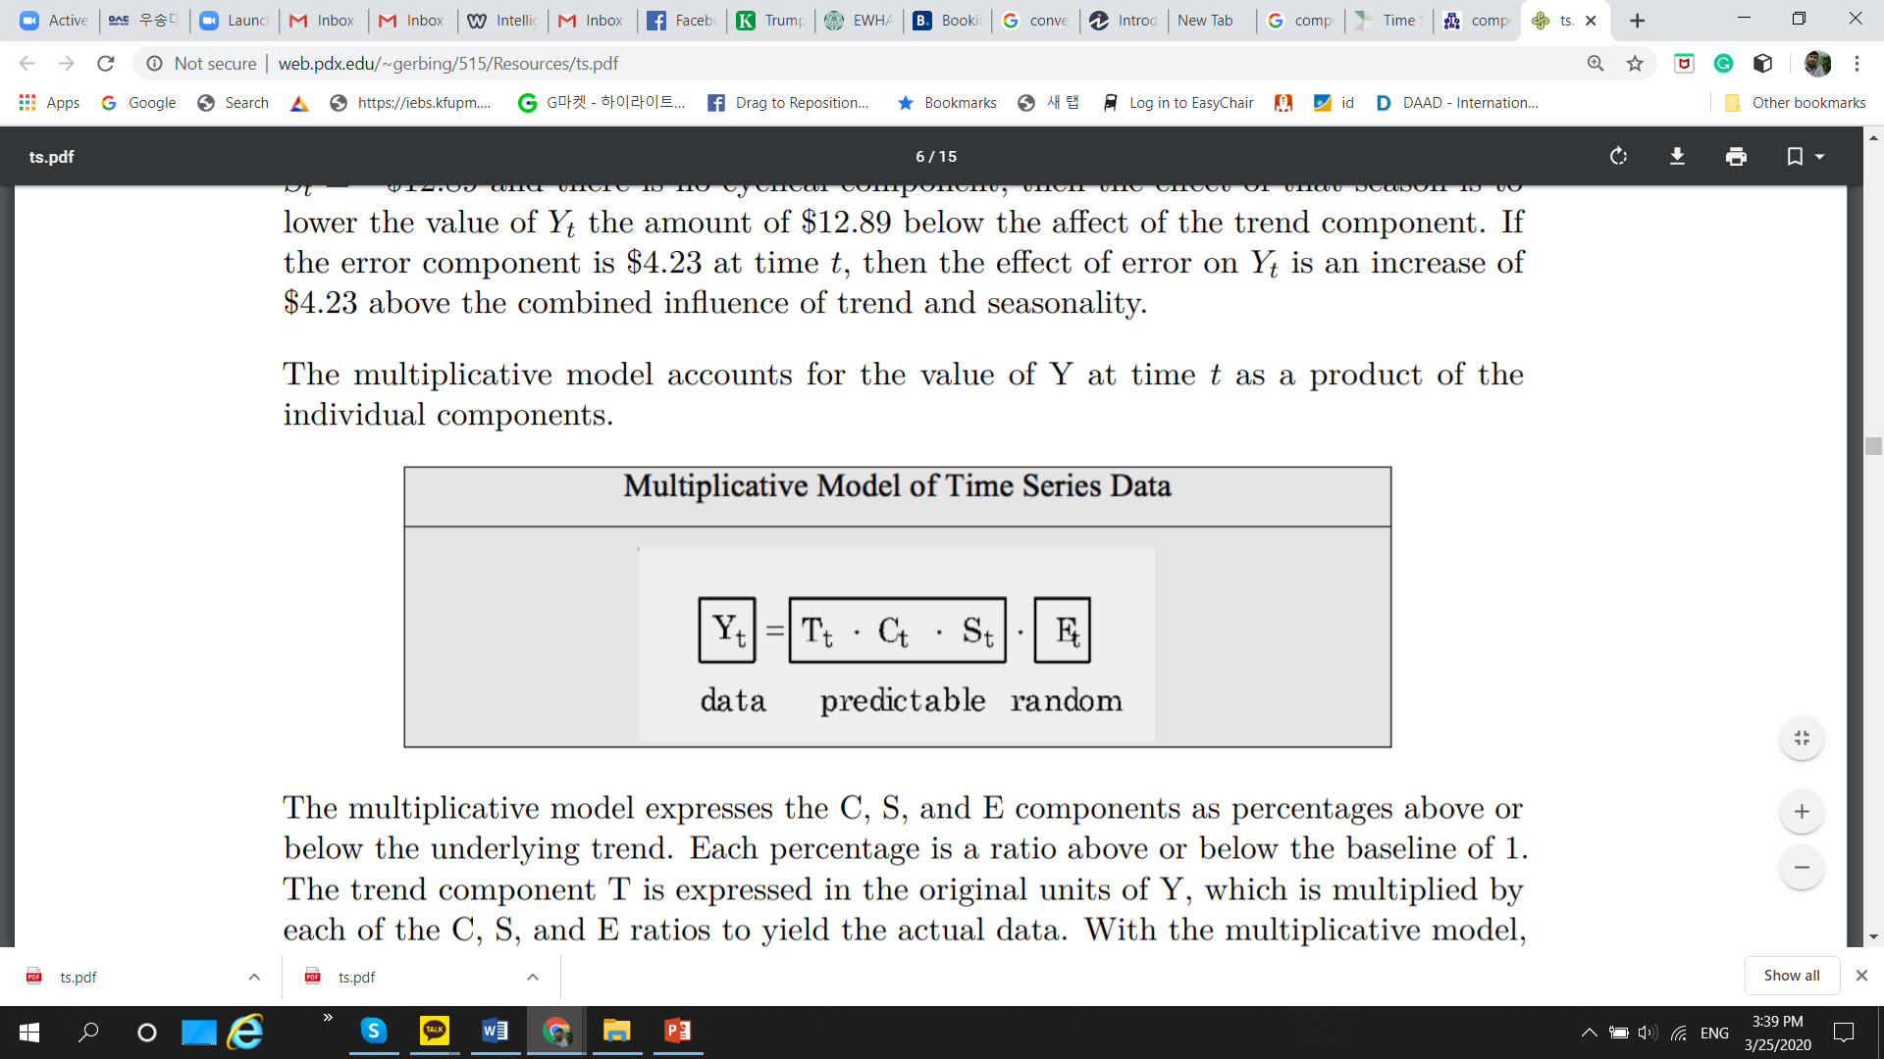
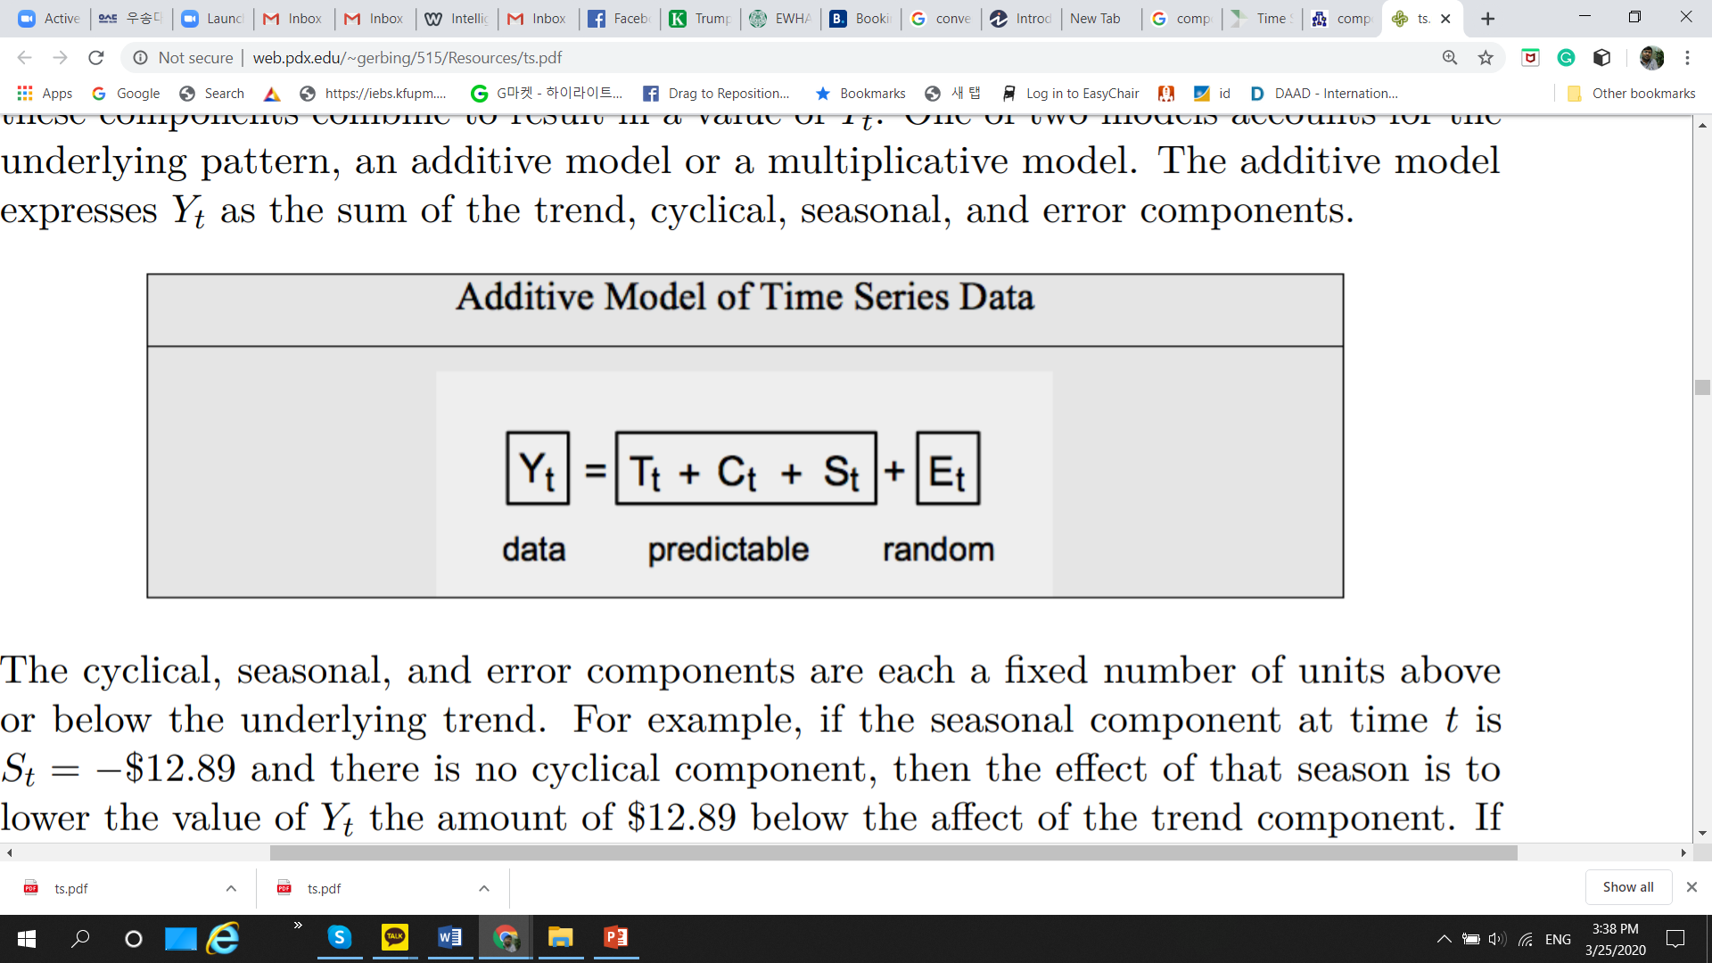
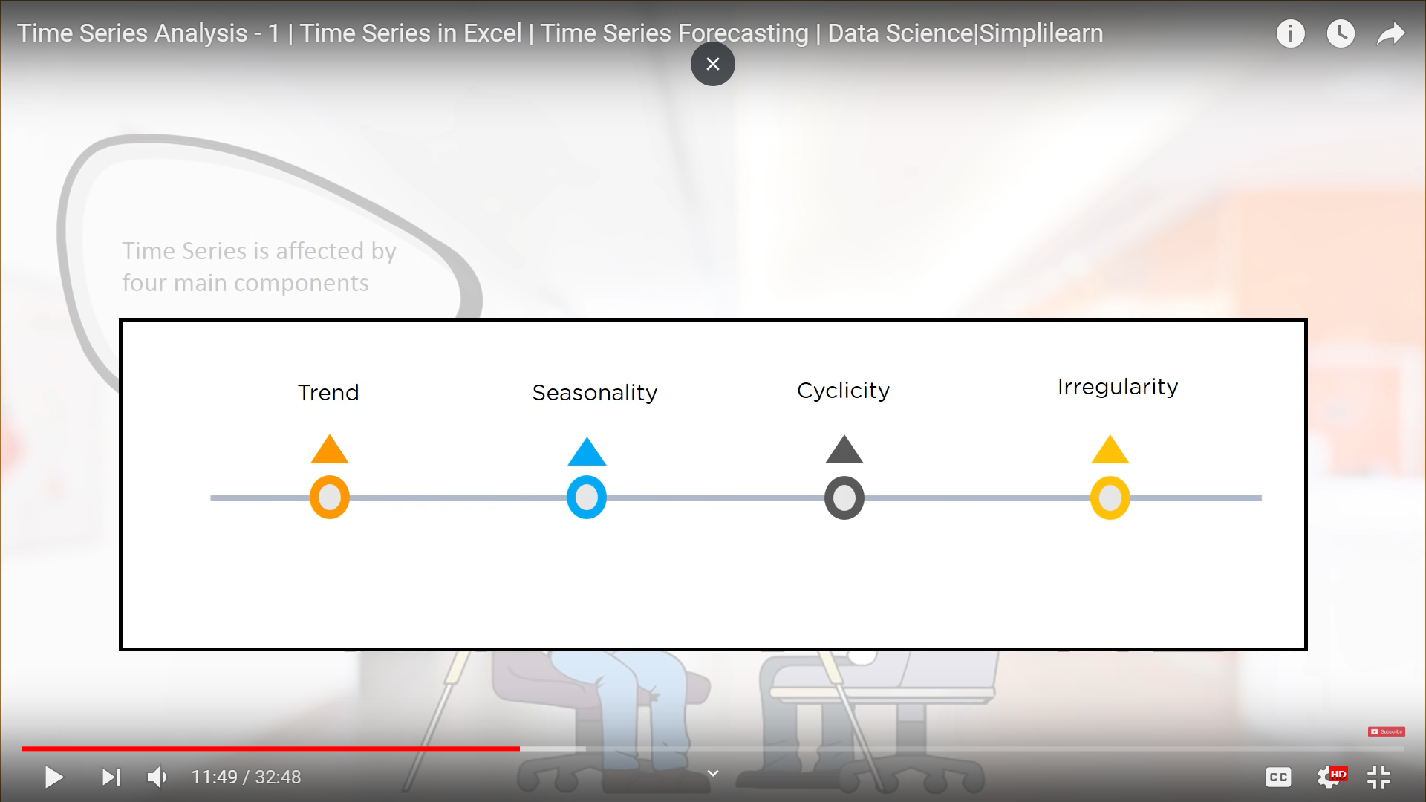
Components of time series data
Notes:
Recurrent-occurring often or repeatedly.
https://thephysicspi.blogspot.com/2019/02/cyclical-variation.html

Slide 51
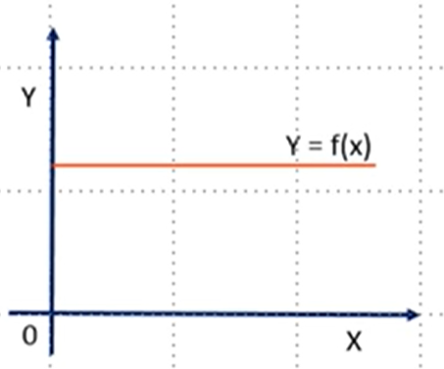
Not to use Time series analysis
when the values are constant over a period of time
Notes:
Recurrent-occurring often or repeatedly.
https://thephysicspi.blogspot.com/2019/02/cyclical-variation.html

Slide 52
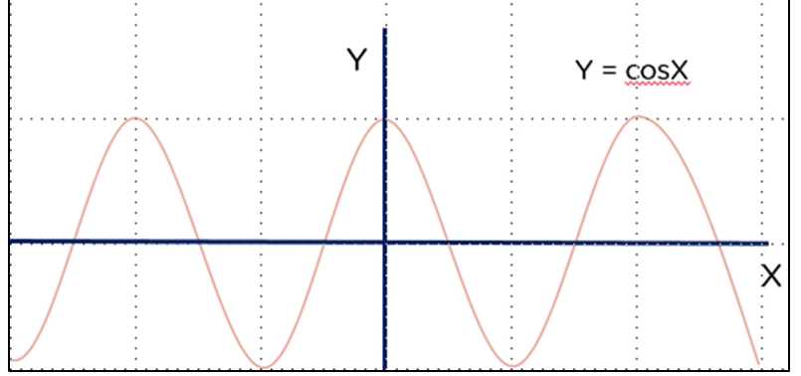
Not to use Time series analysis
When values can be represented by a known functions like cosx, sinx, etc.
Notes:
Recurrent-occurring often or repeatedly.
https://thephysicspi.blogspot.com/2019/02/cyclical-variation.html
Cosx=sin(x+90deg)

